Slide 1
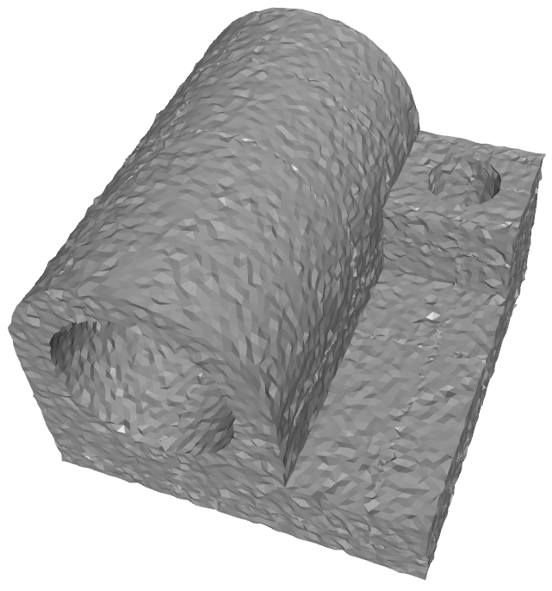
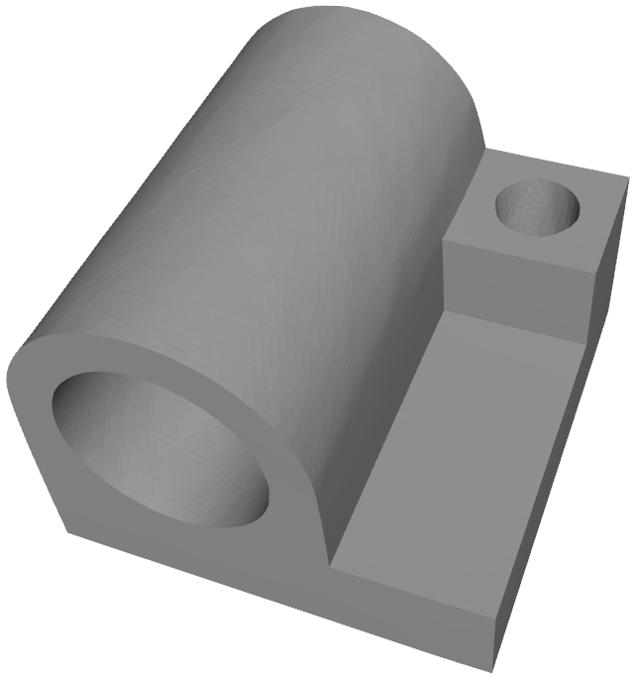


Mesh Total Generalized Variation for Denoising
+1
_{τ} −
−1
−1
−1
+2
τ
_{τ} −−
+1
+2
−2
−1
+1
+
_{τ} +
+2
_{τ} ++
−1
−1
+1
−1
−1
+1
−1
Zheng Liu, Yanlei Li, Weina Wang, Ligang Liu, and Renjie Chen
China University of Geosciences (Wuhan)
Hangzhou Dianzi University
University of Science and Technology of China
Notes:
Good after everyone, I’m Zheng Liu from China University of Geosciences.
I will talk about our work about discretization of total generalized variation over meshes for denoising problem.

Slide 2
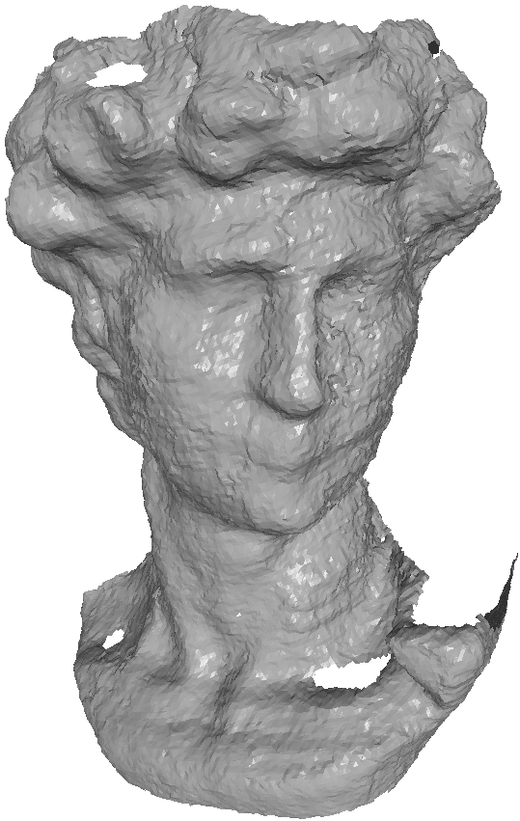
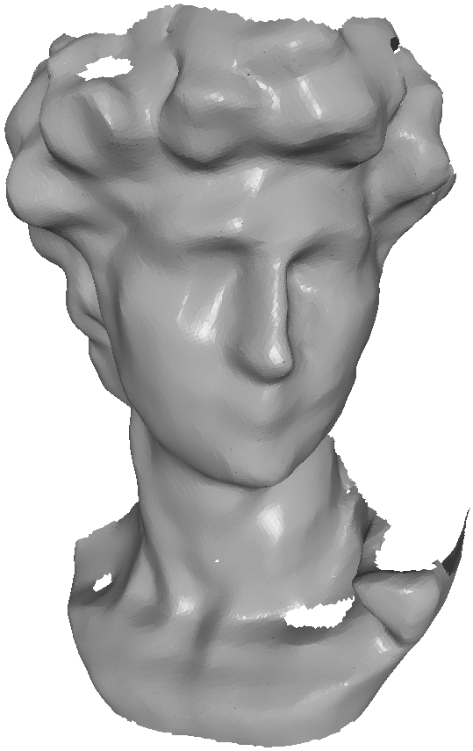
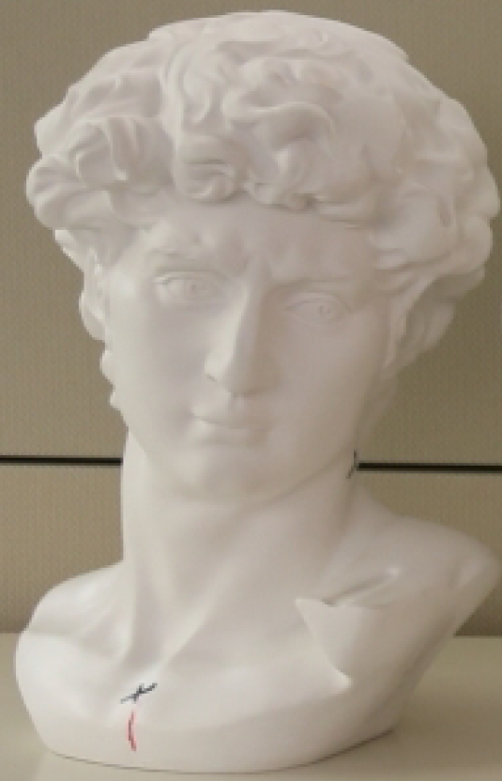
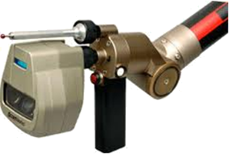
Mesh Denoising
Recovering underlying shapes from noisy input.
Scanning
Denoising
Reconstruction
Noisy mesh
Denoised mesh
Notes:
Mesh denoising is a long standing problem, which has been studied for years.
Nowadays, 3D scanning is a commonplace due to the rapid development of scanning devices.
However, even with high-fidelity devices, the corruption of scanned data is inevitable.
Those noise can not only degrade the visual quality of reconstructed meshes, but also cause errors in the further geometry processing.

Slide 3
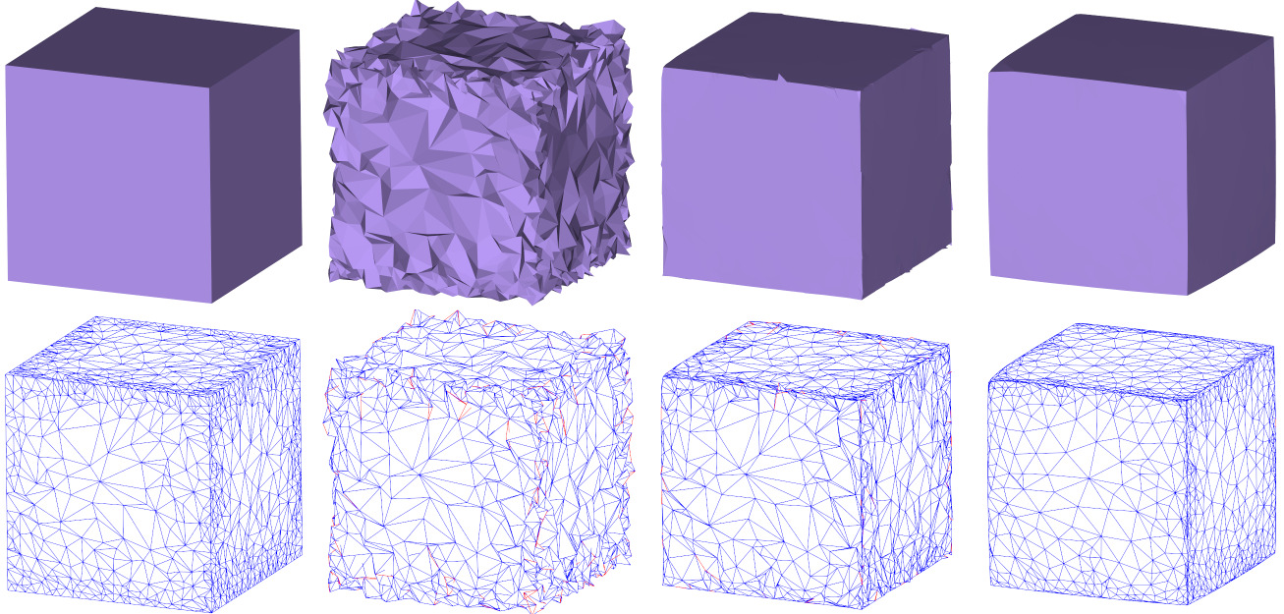
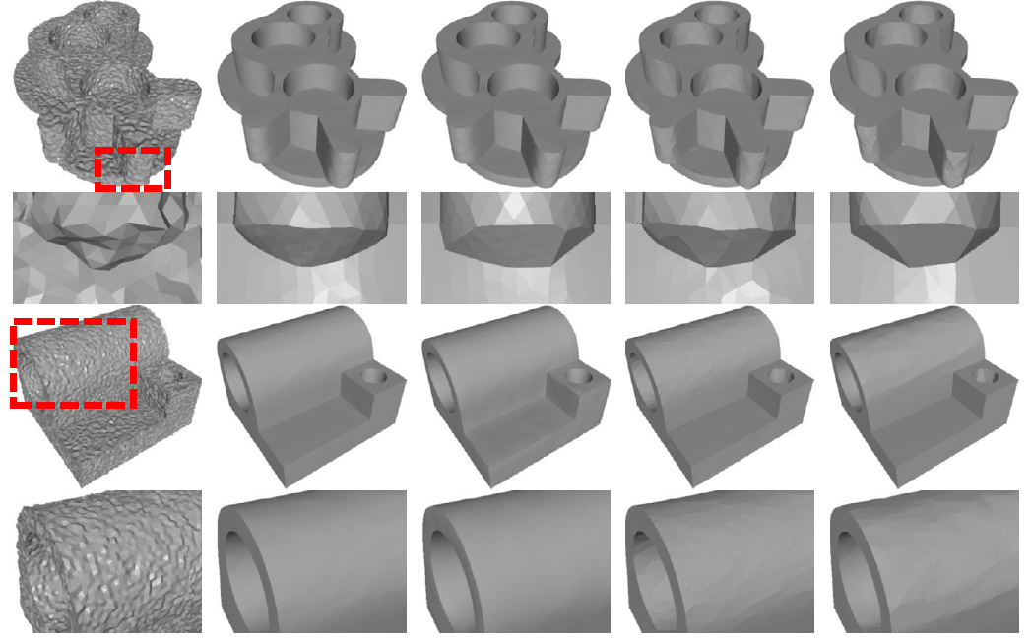
Related Work
Variational methods
L0 Minimization, TV normal filtering tend to produce staircase artifacts in smoothly curved regions;
Second-order normal filtering can prevent staircase artifacts, but blurs fine details and sharp features.
L0 Minimization, [He et al. 2013]
Second Order Normal Filtering,
[Liu et al. 2019]
Total Variation (TV) Normal Filtering,
[Zhang et al. 2015]
Notes:
The mesh denoising methods can be classified into three categories containing variational methods, filtering methods, and data-driven methods.
For variational methods, L0 minimization and Total variation normal filtering preserve sharp features well but produce staircase artifacts in smooth regions.
Second order normal filtering prevents staircase artifacts but blurs sharp features due to its high-order property.

Slide 4
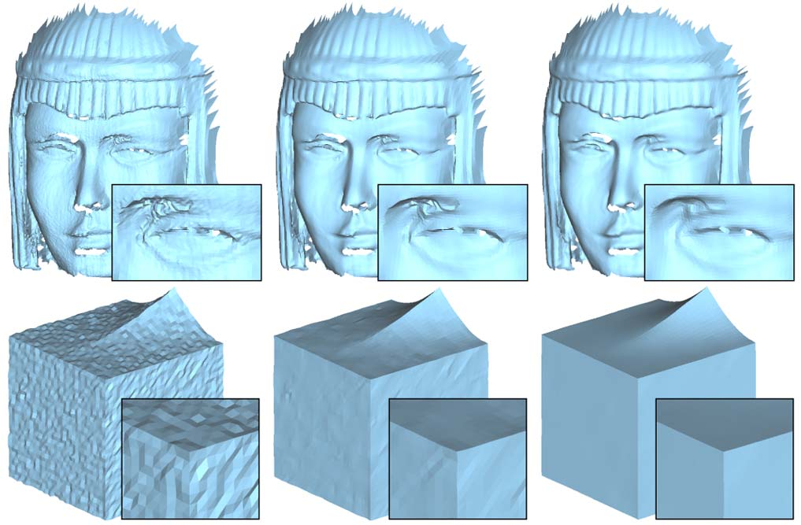
Related Work
Variational methods
L0 Minimization, Total Variation tend to produce staircase artifacts in smoothly curved regions;
Second Order can prevent staircase artifacts, but may blur fine details and sharp features.
Filtering-based methods
Bilateral Normal Filtering may blur sharp features when the noise level increases.
Bilateral Normal Filtering,
[Zheng et al. 2011]
Notes:
Filtering-based methods, such as bilateral normal filtering, are less able to preserve sharp features especially in the case of large noise.

Slide 5
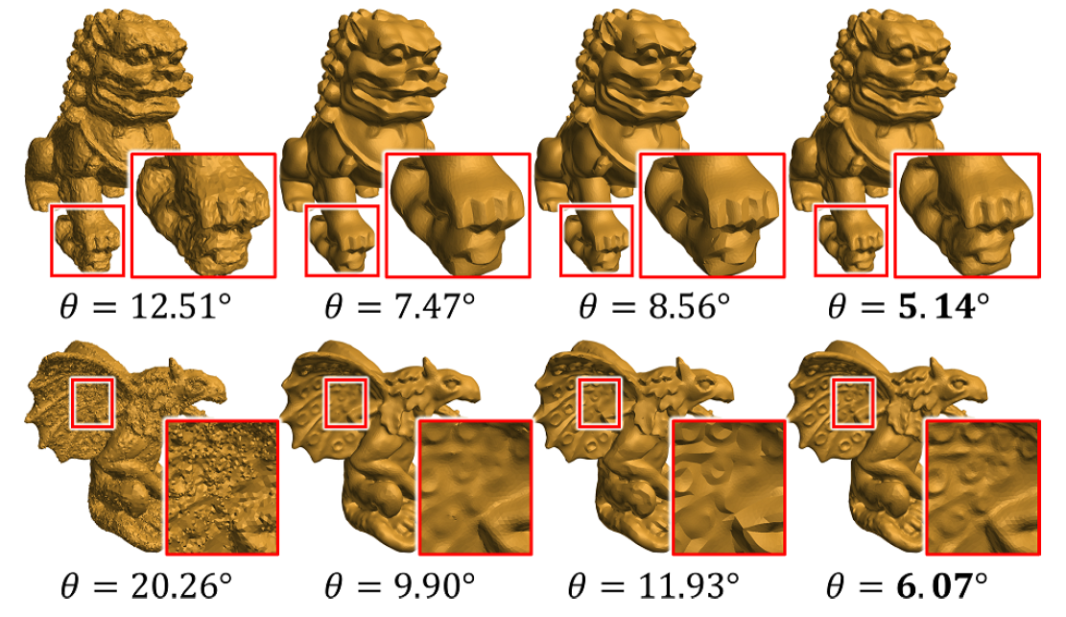
Related Work
Variational methods
L0 Minimization, Total Variation tend to produce staircase artifacts in smoothly curved regions;
Second Order can prevent staircase artifacts, but may blur fine details and sharp features.
Filter-based methods
Bilateral Normal Filtering may blur sharp features when the noise level increases.
Nonlocal-based methods
Non-Local Low-Rank is computationally intensive, and tends to blur sharp features.
Non-Local Low-Rank,
[Li et al. 2018]
Notes:
The nonlocal-based methods are usually computationally intensive, and tends to blur sharp features.

Slide 6
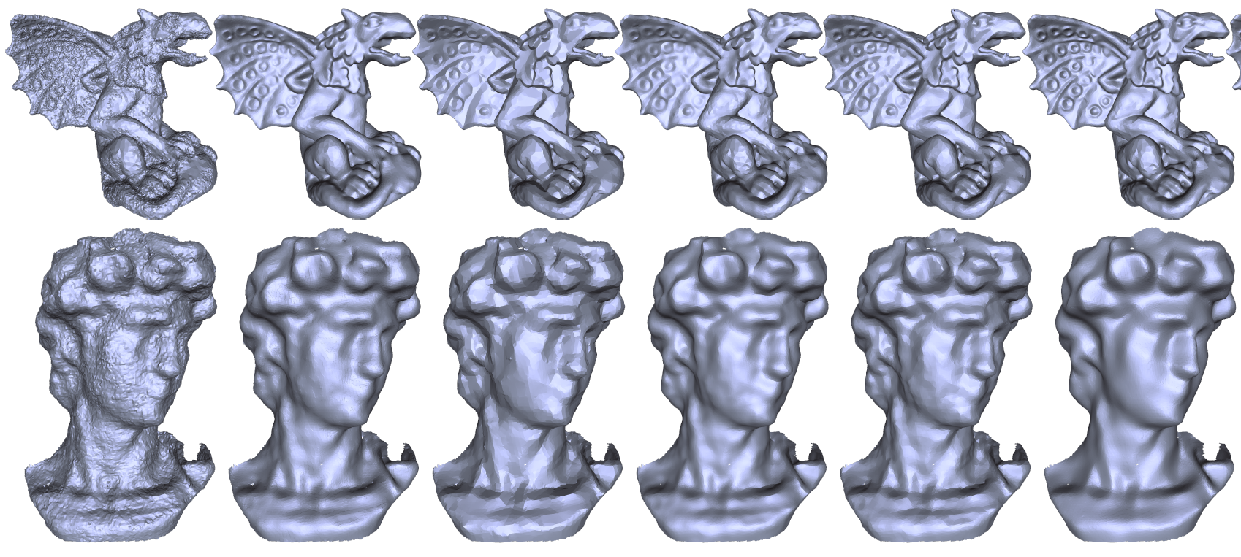
Related Work
Variational methods
L0 Minimization, Total Variation tend to produce staircase artifacts in smoothly curved regions;
Second Order can prevent staircase artifacts, but may blur fine details and sharp features.
Filter-based methods
Bilateral Normal Filtering may blur sharp features when the noise level increases.
Nonlocal-based methods
Non-Local Low-Rank is computationally intensive, and tends to blur sharp features.
Data-driven methods
Cascaded Normal Regression, performance highly depends on the training data set.
Cascaded Normal Regression,
[Wang et al. 2016]
Notes:
The data-driven methods can eﬀectively remove noise and preserve geometric features.
However, they are highly dependent on the completeness of training data set.

Slide 7
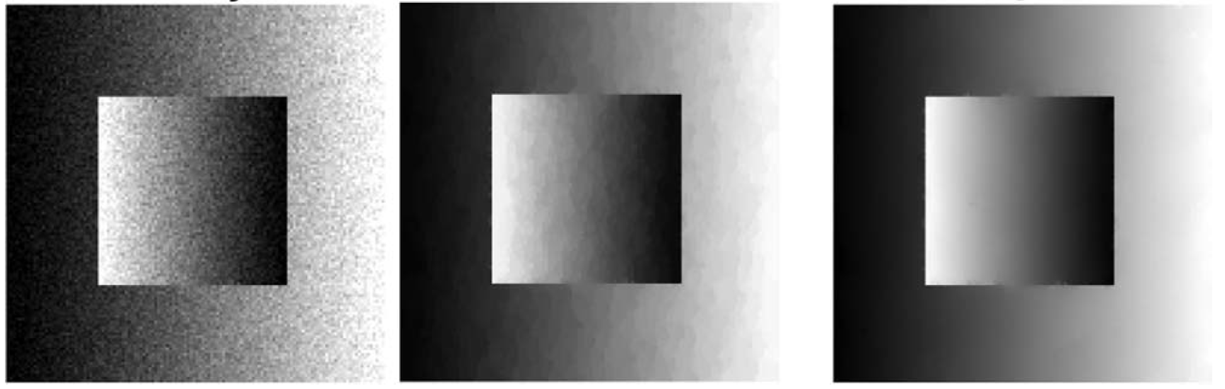
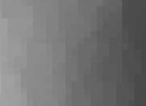
Total Variation
1st-order variation
Staircase artifacts
Noisy
TV
Notes:
The total variation (TV) regularizer is known for its excellent edge-preserving capability in image processing.
However, because TV uses the first-order variation, it suffers from staircase artifacts in smooth regions, which induces false features that do not exist in smooth regions.

Slide 8
Total Generalized Variation
higher-order regularizer
No Artifacts
Noisy
TV
TGV
Notes:
To address this issue, Total Generalized Variation (TGV) is proposed, which is effective both in preserving sharp features and smooth regions for image processing tasks.

Slide 9

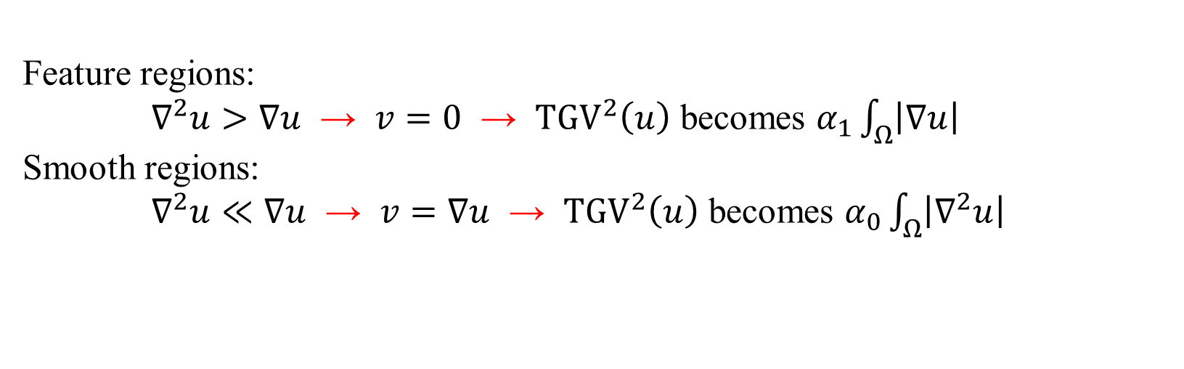
Total Generalized Variation
1st-order term
2nd-order term
Given an image $u$ :
$ξ\left(v\right)= \frac{1}{2}(∇v+∇v^{T})$ : distributional symmetrized derivative ;
Intuition interpretation:
Feature regions:
$∇^{2}u>∇u$ → $v=0$ → ${\text{TGV}}^{2}\left(u\right)$ becomes $α_{1}\int_{Ω}^{ }{\left|∇u\right|}$
Smooth regions:
$∇^{2}u≪∇u$ → $v=∇u$ → ${\text{TGV}}^{2}\left(u\right)$ becomes $α_{0}\int_{Ω}^{ }{\left|∇^{2}u\right|}$
Notes:
TGV is composed of a first-order and a second-order term.
The first-order term allows TGV to locate and preserve sharp features, while the second-order term allows it to recognize and recover smooth regions.
In feature regions, second-order gradient u is larger than gradient u, hence the minimum of TGV tends to have v be equal to 0 in these regions, resulting in TGV becomes first-order variation of u in feature regions.
In contrast, in smooth regions, the second-order gradient u is small locally, and the minimum of TGV is obtained by choosing gradient u be equal to v, resulting in TGV becomes second-order variation of u in smooth regions.
Thus, under the help of edge-aware variable v, TGV automatically balances between first- and second-order Variations.

Slide 10
Contributions
The first numerical framework for discretizing TGV over triangular meshes.
A normal filter using TGV-based regularization
Notes:
Although TGV has become one of the most popular regularization technique in image processing, currently there is no existing work that is suitable for applying TGV to triangular meshes.
In this work, We define necessary discrete operators and further use these operators to apply TGV to meshes.
Then, We present a normal filter using TGV-based regularization.
Our method is able to preserve sharp features and recover smooth regions, while preventing unnatural artifacts.

Slide 11
Discretization
How to calculate these over a mesh?
We need to define function space and operators to discretize them.
Notes:
Then the problem is how to calculate gradient u, v and epsilon v over meshes.
We need to define function space and operators to discretize them

Slide 12
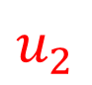
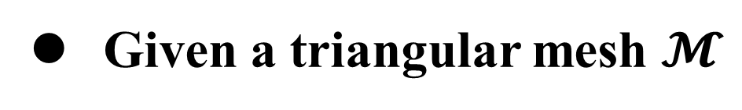
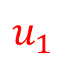


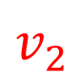
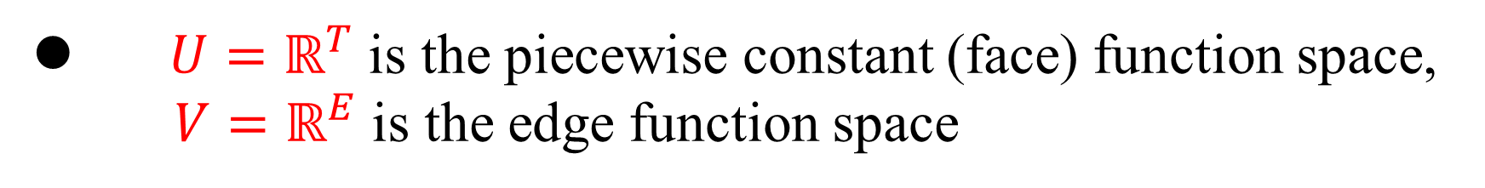
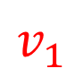
Function Spaces
Given a triangular mesh $𝓜$
$$v_{1}$$
define $u∈U$ restricted on triangles
$$u_{1}$$
define $v∈V$ restricted on edges
$$u_{2}$$
$$v_{2}$$
$U=ℝ^{T}$ is the piecewise constant (face) function space,
$V=ℝ^{E}$ is the edge function space
Notes:
In order to describe face normal field on a mesh M, we introduce the piecewise constant function space U, whose elements are defined at faces.
In order to further describe function v, we propose the edge function space V, whose elements are defined at edges.

Slide 13
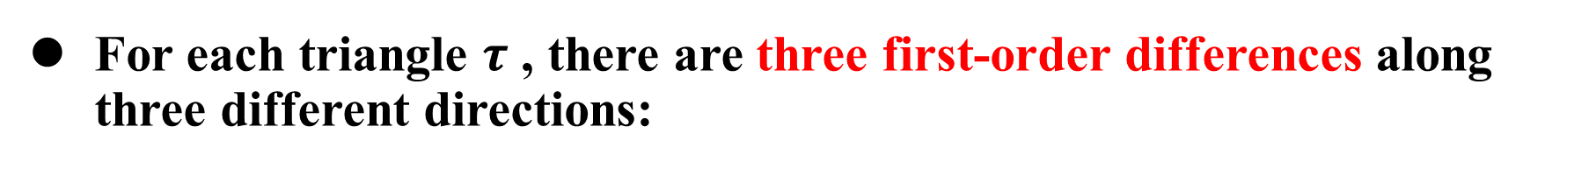
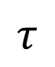
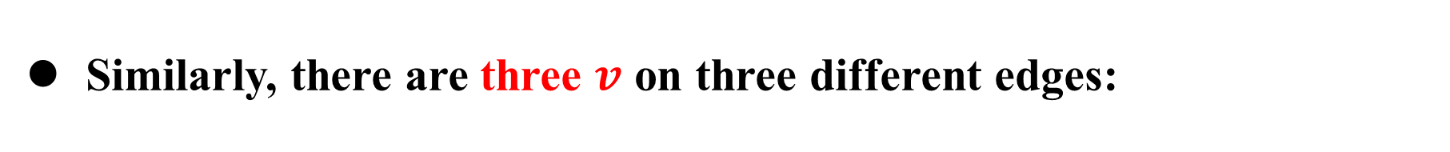
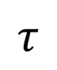
Discretization
For each triangle $τ$ , there are three first-order differences along three different directions:
$$τ$$
(1st-order) gradient of u
2nd-order gradient of u
Similarly, there are three $v$ on three different edges:
$$τ$$
gradient of v
Notes:
In the discrete case, for each triangle tau, there are three first-order differences over the edges along three different directions.
Thus, we can approximate gradient u as follows.
Then, it is natural to denote the second-order gradient u as this.
Similarly, there are three $v$ on three different edges, and the gradient v can be defined as following.

Slide 14
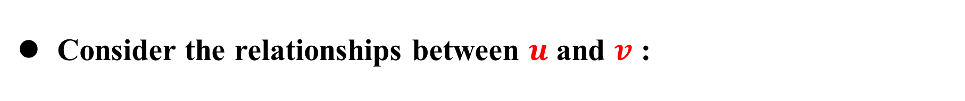
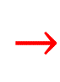

Consider discretization of first- and second-order gradient of u
Consider discretization of v and first-order gradient of v
Consider the relationships between $u$ and $v$ :
Main diagonal
entries
$$→$$
$$→$$
Off-diagonal
entries
2-form operator for discretizing off-diagonal entries
1-form operator for discretizing main diagonal entries
Notes:
Now, we need to discretize gradient u and second-order gradient u, and gradient v.
Moreover, we must consider the relationships between variables u and v in our discretization framework.

Slide 15
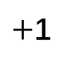
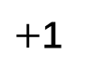
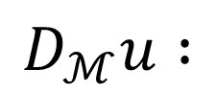
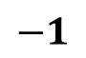
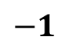
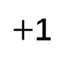
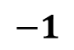
First-order difference operator
$$D_{ℳ}u :$$
$$−1$$
$+$1
$$−1$$
$+$1
$+$1
$$τ$$
$$−1$$
$$τ$$
Notes:
Here, we propose first-order difference operator of u to discretize the first-order derivatives of gradient u.

Slide 16
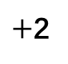

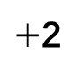
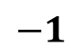


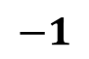
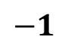
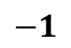
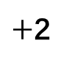
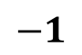
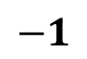
1-form operator
$$−1$$
$$−1$$
$+$2
$+$2
$$−1$$
$$−1$$
$+$2
$$−1$$
$$−1$$
$$l$$
$$l$$
$$l$$
Notes:
Then we propose 1-form operator for discretizing main diagonal entries of gradient v.
the 1-form operator of v depicts the variation of v over the two adjacent edges.
Moreover, this operator can also be considered as the second-order operator of u in the same direction.
Thus, the 1-form operator can be used for discretizing main diagonal entries of gradient v, and main diagonal entries of second-order gradient u.

Slide 17
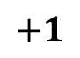
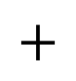
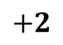
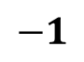
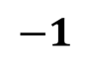
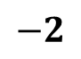
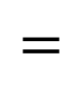
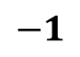










2-form operator
$$+1$$
$$+1$$
$$+2$$
$$−1$$
$$−1$$
$$−1$$
$$−2$$
$$−1$$
$$+$$
$$=$$
$$+1$$
$$+1$$
$$+2$$
$$−1$$
$$−1$$
$$c$$
$$+$$
$$=$$
Notes:
From this page we can see that, 2-form operator of v describes the sum of variations of v across edges.
And this operator can also be considered as the second-order operator of u (in different directions).
In other words, the 2-form operator can be used to depict both first-order derivatives of v, and second-order derivatives of u in different directions.

Slide 18
Discretized TGV
Now we can formulate the discretized TGV as:
1-form operator
1st-order difference operator
2-form operator
Notes:
Now, by using the operators, we can formulate the discretized TGV as following.

Slide 19

TGV Normal Filtering
Fidelity Term
TGV Regularizer Term
where
${\text{N}}^{in} :$noisy face normal defined on faces
$\text{N} :$ optimized face normal defined on faces
v : function defined on edges
Notes:
To remove mesh noise, we propose a TGV-based normal filtering model.
Given a noisy mesh, we assume N to be the normal field defined on faces, and v to be a function to represent the discontinuity of the face normals.

Slide 20


Normal Filtering Based on TGV
By introducing new variables , and , reformulate it into a constrained optimization problem:
we further introduce the augmented Lagrangian as follows:
$$\left.ℒ\left.(\right.N,v,P,\overline{Q},\tilde{Q};λ_{P},λ_{\overline{Q}},λ_{\tilde{Q}})\right.$$
Notes:
By introducing new variables, we reformulate the TGV normal filtering model as a constrained problem as following.
To solve the above constrained problem, we introduce Lagrange multipliers and
reformulate the above problem as an augmented Lagrangian function.

Slide 21





Normal Filtering Based on TGV
Then we apply the variable-splitting technique and iteratively update the different set of variables:
$N$-sub problem:
$v$-sub problem:
$P$-sub problem:
$\overline{Q}$-sub problem:
$\tilde{Q}$-sub problem:
Notes:
Then we apply the variable-splitting technique and iteratively update the 5 different set of variables in alternation.

Slide 22












Experiments – Stress Test
Our method is robust against different levels of noise:
$$σ=0.2{\overline{l}}_{e}$$
$$σ=0.4{\overline{l}}_{e}$$
$$σ=0.6{\overline{l}}_{e}$$
$$σ=0.75{\overline{l}}_{e}$$
Notes:
This page shows the robustness of our method against different levels of noise.

Slide 23




Experiments – Non-uniform Sampling
Our method is robust against non-uniform sampling:
Noisy input
Result
Notes:
We also verify the effectiveness of our method on non-uniform sampling data.

Slide 24

Experiments - Comparisons
Comparing with state-of-the-arts:
TV, [Zhang et al. 2015]
HO, [Liu et al. 2019]
L0, [He et al. 2013]
BF, [Zheng et al. 2011]
NLLR, [Li et al. 2018]
CNR, [Wang et al. 2016]
Error metrics:
θ，average angular difference (in degrees)
E_{v} , vertex-based Hausdorff distance ($×{10}^{−2}$)
Notes:
We compare our method with the following state-of-the-arts.
And we use the average angular difference to measure the normal errors, and the vertex Hausdroff distance to measure the vertex deviation.

Slide 25

Comparisons
Noisy
TV
HO
L0
BF
NLLR
CNR
Ours
θ = 3.12° | θ = 2.90° | θ = 4.35° | θ = 5.30° | θ = 11.7° | θ = 2.63° | θ = 1.88°
E_{v} = 2.01 | E_{v} = 1.70 | E_{v} = 2.15 | E_{v} = 1.80 | E_{v} = 2.44 | E_{v} = 0.86 | E_{v} = 0.95
Notes:
We compare results for a CAD mesh containing sharp features and smooth regions.
our method TGV is free from staircase artifacts in smooth regions, which makes it an significant improvement over TV and L0.
Compared to HO, our method recovers sharp features and flat regions more accurately.
From the error colormaps, we also can see the normals produced by our method are noticeably closer to the ground truth.

Slide 26

Comparisons
Noisy
TV
HO
L0
BF
NLLR
CNR
Ours
θ = 2.62° | θ = 3.67° | θ = 3.92° | θ = 5.51° | θ = 8.21° | θ = 2.31° | θ = 2.20°
E_{v} = 2.39 | E_{v} = 1.67 | E_{v} = 2.17 | E_{v} = 1.62 | E_{v} = 1.57 | E_{v} = 1.47 | E_{v} = 1.20
Notes:
In this page, we compare results for a non-CAD surface with rich features.
As we can see, the non-local method NLLR and our method produce more appealing results with geometric features recovered better than all competing methods.
However, our method achieves higher numerical accuracy than NLLR.

Slide 27
Runtime
in seconds
Less
Than
1′30″
Notes:
As we can see in this page, CNR is the fastest method, thanks to its pre-trained neural networks.
NLLR is the slowest one for its non-local property.
The runtime of our method is within 1 minute 30 seconds for all the tested data.

Slide 28
Conclusion
Limitations
Too much (five) parameters need to be tuned.
A little computationally intensive for large-scale meshes.
Future Work
More applications: Segmentation, Reconstruction, Simplification, Feature detection.
Extension to point clouds.
Notes:
Now let’s conclude this talk.
We first present a numerical framework to discretize TGV over meshes.
Then, a normal filter based on TGV is proposed to smooth normal fields.
Our method is highly effective for denoising CAD and man-made surfaces that contain sharp features and smooth regions.
Here are still some limitations for our method.
Some future works are left open. The TGV discretization can be applied for more geometry processing tasks.
Moreover, it would be interesting to extend this discretization over point clouds.

Slide 29

Project Homepage
https://github.com/LabZhengLiu/MeshTGV
Thanks for you attention!
Notes:
This is the homepage of our work.

